Slide 1


Computational Biology
Bovine serum albumin(target-decoy and spectrum alignment)

Slide 2
Team name
محمد فتحي سيد section(4) group(3)
عطا احمد عطا section(1) group(3)
علاء احمد جمال section(1) group(3)
محمد مدحت محمد section(4) group(3)
محمود عبد الغني مصطفي section( ) group( )
محمود مدحت محمد section( ) group( )
عمار عبد الناصر عبد الغني section(1) group(3)

Slide 3
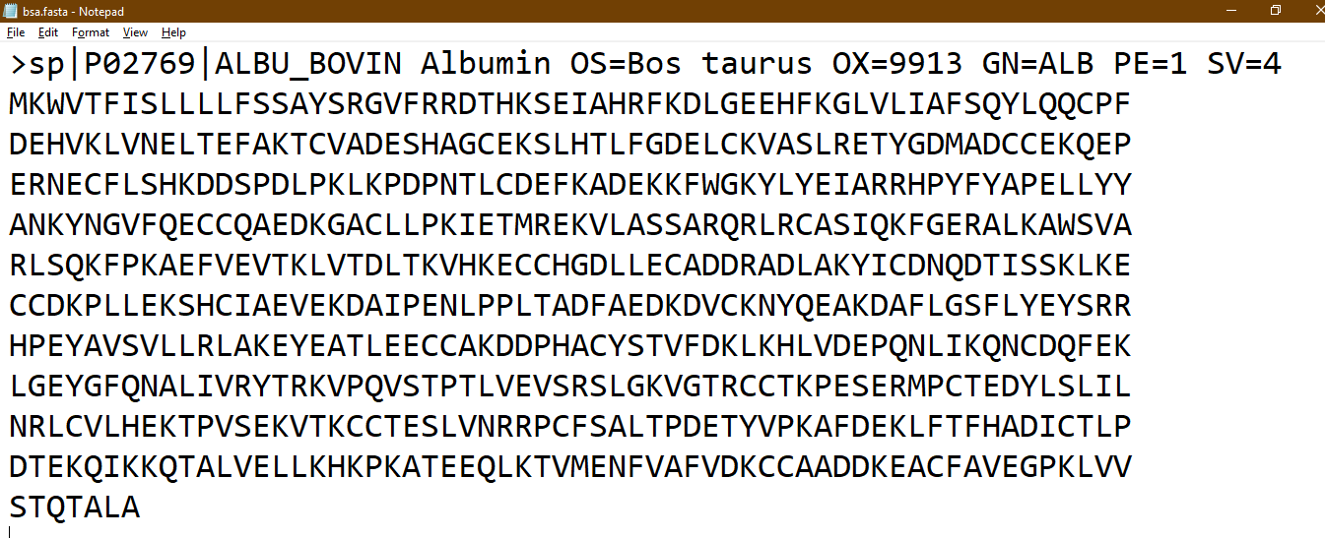
Sequence

Slide 4
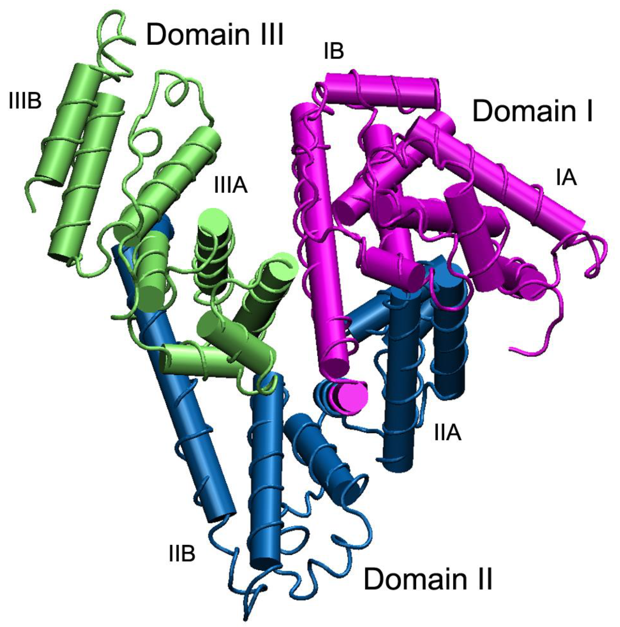
what is Bovine Serum Albumin(BSA)

Slide 5
what is Bovine Serum Albumin(BSA)
Bovine Serum Albumin (BSA), also known as "Fraction V", is a protein derived from bovine blood plasma and is a byproduct of the food industry. The nickname "Fraction V" is based on the plasma protein extraction method by Cohn, which makes use of the different solubility behavior of the plasma proteins. In this fractionation, BSA represents the fifth fraction and is based on cold ethanol precipitation.

Slide 6
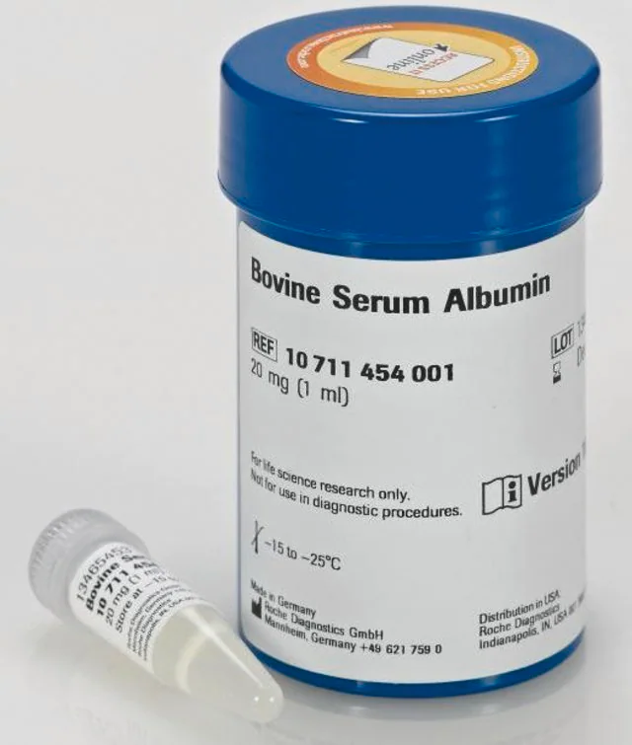
How I can get mature BSA protein

Slide 7
How I can get mature BSA protein
In order to yield the mature BSA protein, the full-length precursor protein (607 amino acids in length) is modified in two steps: First, a signal peptide (18 AAs) is cut off upon secretion. During the second step – that yields the mature BSA protein – an additional 6 amino acids are removed. The final BSA product then contains 583 amino acids.

Slide 8
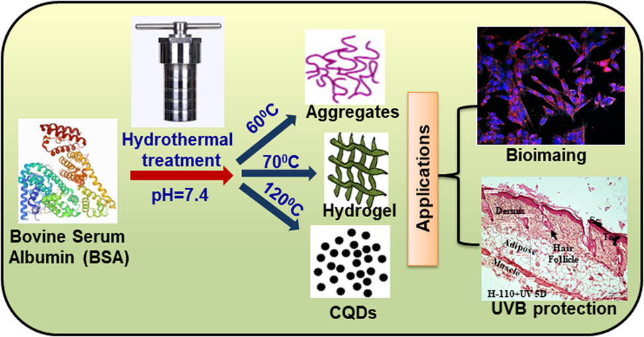
Applications of mature BSA

Slide 9
Applications of mature BSA
BSA is used as a blocker in immunohistochemistry to bind to non-specific binding sites. When BSA binds to these, it increases the chance that your antibodies will bind only to the antigens of interest. In the same manner, it also decreases the background noise. These two mechanisms are important, as you want to increase your signal-to-noise ratio for best results.
Further, BSA is also used for quantification of other enzymes. Here, the known amount of BSA protein is compared to an unknown amount of your protein of interest

Slide 10
Applications of mature BSA
Western Blot, IP, and IHC.
FACS and other detection methods.
in microbial cultures as a nutrient source.
for use with restriction enzymes and other proteins/conjugates for stabilization
as a carrier protein for conjugates.
to prevent adhesion of enzymes to vessels and pipette tips.

Slide 11
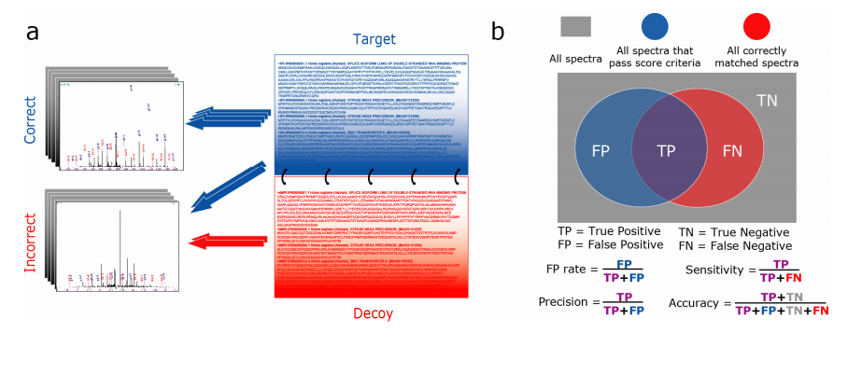
what is target-decoy method

Slide 12
what is target decoy method
The TDA method matches the spectra to a database of real (targets) and nonsense peptides (decoys). A popular approach to generate these decoys is to reverse the target database. Hence, all the PSMs that match to a decoy are known to be bad hits and the distribution of their scores are used to estimate the distribution of the bad scoring target PSMs(peptide to spectrum match). A crucial assumption of the TDA is that the decoy PSM hits have similar properties as bad target hits so that the decoy PSM scores are a good simulation of the target PSM scores

Slide 13
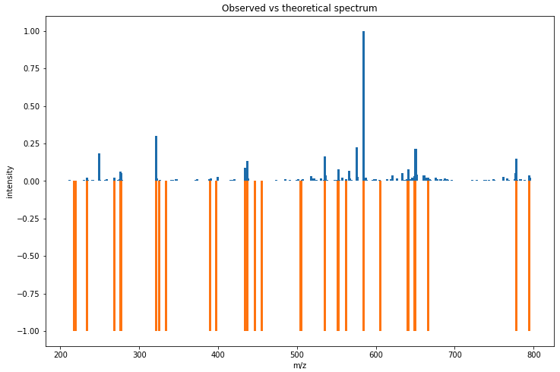
why spectrum alignment

Slide 14
why spectrum alignment
to alignment (or matching) of any two mass spectra to get a list of matching peak indices between a query and target spectrum. In particular, we examine the alignment of a reference mass spectrum in database, with a measured sample mass spectrum

Slide 15
Why we use target-decoy
A first step in the data analysis of MS based proteomics data is to identify peptides and proteins. With this respect the huge number of experimental mass spectra typically have to be assigned to theoretical peptides derived from a sequence database. Search engines are used for this purpose. These tools compare each of the observed spectra to all candidate theoretical spectra derived from the sequence data base and calculate a score for each comparison. The observed spectrum is then assigned to the theoretical peptide with the best score, which is also referred to as PSMs. It is of course crucial for the downstream analysis to evaluate the quality of these matches. Therefore, False Discovery Rate (FDR) control is used to return a reliable list PSMs. The FDR, however, requires a good characterization of the score distribution of PSMs that are matched to the wrong peptide (bad target hits). In proteomics, the target decoy approach (TDA) is typically used for this purpose.

Slide 16


